Slide 1
Object Oriented Analysis And Design

Slide 2
Course Objectives
Explain & illustrate the fundamental concepts of object orientation
To introduce basic concepts of object oriented analysis & design
To study the main features of the software development process in an object oriented framework
To produce exposure to Visual Object Oriented Modeling language specifically UML (Unified Modeling Language)
Read, verify & validate given specification presented in UML
Given a system requirements description, produce a specification & implementation using UML

Slide 3
1. Object Oriented Fundamentals [10Hrs- 18Marks]
Introduction
Object Oriented Analysis & Design
Defining Models
Case Study
Requirement Process
Use Cases
Object Oriented Development Cycle
Overview of the Unified Modeling Language: UML fundamentals and Notations

Slide 4
2. Object Oriented Analysis [8Hrs-14Marks]
Building Conceptual Model
Adding Associations & Attributes
Representation of System Behavior

Slide 5
3 .Object Oriented Design [12Hrs-21Marks]
Analysis to Design
Describing & Elaborating Use Cases
Collaboration Diagram
Objects & Patterns
Determining Visibility
Class Diagram

Slide 6
4. Implementation [15Hrs-27Marks]
Programming & Development Process
Mapping Design to Code
Creating Class Definitions from Design Class Diagram
Creating Methods from Collaboration Diagram
Updating Class Definition
Classes in Code
Exceptions & Error Handling

Slide 7
Laboratory Exercise
Lab1: Installation of Rational Rose
Lab2: Preparation of Use Case Diagrams using a tool for different scenarios
Lab3: Preparation of Sequence Diagrams using a tool for different scenarios
Lab4: Preparation of Class Diagrams using a tool for different scenarios
Lab5: Preparation of state transition diagrams using a tool for different scenarios

Slide 8
Reference Books
Larman, C., Applying UML and Patterns, Pearson Education Asia, 2008.
Stevens, P., Pooley, R., Using UML: Software Engineering with Objects and Components, Addision-Wesley, 2007.
Booch, G., Jacobson, I., Rumbaugh, J., The Unified Software Development Process, Addision-Wesley, 2009.
Booch, G., Jacobson, I., Rumbaugh, J., The Unified Modeling Language User Guide, Addision-Wesley, 2008.
Jacobson I., Object-Oriented Software Engineering- A Use Case driven Approach, Addision-Wesley, 2009.

Slide 9
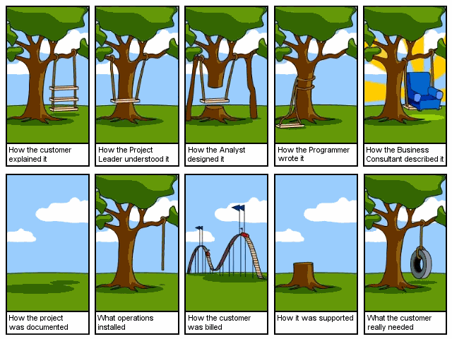
Motivation

Slide 10
Motivation
Why do we need it?
standard notation
communication tool
Why object-oriented?
Conceptual diagrams use “objects”
Inspired by OO paradigm (programming and languages)
“The "software crises" came about when people realized the major problems in software development were … caused by communication difficulties and the management of complexity” [Budd]

Slide 11
OOAD - Definition
OOAD is a popular technical for
Analyzing
Designing and application, system or business
By applying OO paradigm &
Visual modeling throughout the development life cycles for better communication

Slide 12
OOP
OOP is based on a concept of “Objects”
Which are data structures that contain data
In the form of fields
Often known as attributes
& code in the form of procedures
Often known as methods

Slide 13
OOD history
OO in the `60s & `70s – Informal notions
Simula, Smalltalk
In `82, Grady Booch coined the term Object Oriented Design
The idea was to combine a design methodology with language constructs that implement design concepts
Objects in design space are classes in implementation space

Slide 14
Pros and cons of OOA&D
Advantages | Disadvantages
Focuses on data rather than the procedures as in Structured Analysis. | Functionality is restricted within objects. This may pose a problem for systems which are intrinsically procedural or computational in nature.
The principles of encapsulation and data hiding help the developer to develop systems that cannot be tampered by other parts of the system. | It cannot identify which objects would generate an optimal system design.
The principles of encapsulation and data hiding help the developer to develop systems that cannot be tampered by other parts of the system. | The object-oriented models do not easily show the communications between the objects in the system.
It allows effective management of software complexity by the virtue of modularity. | All the interfaces between the objects cannot be represented in a single diagram.
It can be upgraded from small to large systems at a greater ease than in systems following structured analysis.
* https://www.tutorialspoint.com/object_oriented_analysis_design/ooad_object_oriented_analysis.htm

Slide 15
Definitions
Analysis — understanding, finding and describing concepts in the problem domain.
Grady Booch has defined OOA as, “Object-oriented analysis is a method of analysis that examines requirements from the perspective of the classes and objects found in the vocabulary of the problem domain”.
Design — understanding and defining software solution/objects that represent the analysis concepts and will eventually be implemented in code.
OOAD — a software development approach that emphasizes a logical solution based on objects.

Slide 16
OOA&D Principles
Major principles:
Abstraction
Encapsulation
Modularity
Hierarchy
Minor principles:
Typing
Concurrency
Persistence

Slide 17
Design Goals for OOD
Booch defined three goals
Identify the objects/classes
Identify the functionality of these objects/classes
Identify the relationship between these objects/classes
This is an iterative process
Decisions in design space are complex
Identification and specification of one aspect of a class might force changes in other aspects

Slide 18
UML supported diagrams
class
object
component
package
deployment
use case
interaction
communication
sequence
collaboration
timing
activity
robustness

Slide 19
Overview
UML supported diagrams
use case - description of functionality provided by system along with actors and their connection to the use case
object - set of objects and their relationships
class - set of classes, interfaces, collaboration, relationships
interaction - set of objects and their relationships including messages
state/statechart - a state machine showing states, transitions, events, and activities
activity - statechart sequential flow of activities
component - physical structure of code in terms of code components

Slide 20
Overview (cont-d)
UML supported diagrams
deployment - physical architecture of hardware and software in the system
package - shows packages of classes and dependencies among them
grouping mechanism
form of class diagram
also called subsystem

Slide 21
Organization of Diagrams
Behavior diagrams
use case
sequence
robustness
Structure diagrams
class
component
deployment
package

Slide 22
Overview of Software Engineering

Slide 23
Software?
Instructions providing desired function and performance
Computer Programs Associated Documentation
Data structure that enable program to adequately manipulate information
Documents describing operations and use of programs
Both a product and a vehicle for developing a product
Software is engineered not manufactured
Does not wear out but it does deteriorate
Two Types of Software Products Generic: stand alone systems , sold to any one , shrink wrapped s/w
e.g databases , word processors, drawing packages
Customized: commissioned by a particular customer
air trafic control systems, systems to support a particular business

Slide 24
Software Engineering/System Engineering
Software engineering
System engineering
is part of
Concerned with all aspects of software production
Concerned with all aspects of computer-based systems development including
hardware,
software and
process engineering
System engineers are involved in
system specification, architectural design, integration and deployment

Slide 25
Software Process
Software Process:
set of activities whose goal is development or evolution of software
Specification - what the system should do and its development constraints
Evolution - changing the software in response to changing demands
Generic activities in all software processes
Development - production of software system
Validation - checking that the software is what the customer wants

Slide 26
Software Process Model
A simplified representation of a software process, presented from a specific perspective
Workflow perspective: inputs, outputs and dependencies
Data-flow perspective: data transformation activities
Role/action perspective: roles/activities of the people involved in software process
Generic process models
Waterfall
Evolutionary development
Formal transformation
Integration from reusable components

Slide 27
Costs of Software Engineering
Roughly 60% of costs are development costs, 40% are testing costs. For custom software, evolution costs often exceed development costs
Costs vary depending on the type of system being developed and the requirements of system attributes such as performance and system Reliability
Distribution of costs depends on the development
model that is used

Slide 28
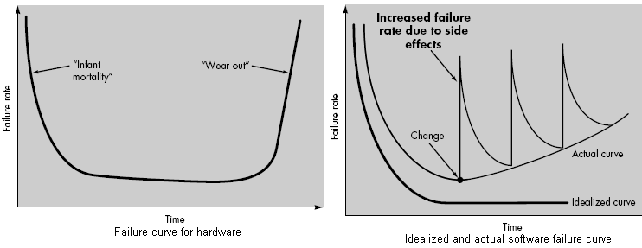
Software Failure Curve

Slide 29
What is CASE (Computer-Aided Software Engineering)
Software systems which are intended to provide automated support for software process activities.
CASE systems are often used for method support
Upper-CASE
• Tools to support the early process activities of requirements
and Design
Lower-CASE
• Tools to support later activities such as programming,
debugging and testing

Slide 30
What are the attributes of good software?
The software should deliver the required functionality and performance to the user and should be maintainable, dependable and usable
Maintainability
• Software must evolve to meet changing needs
Dependability
• Software must be trustworthy
Efficiency
• Software should not make wasteful use of system resources
Usability
• Software must be usable by the users for which it was designed

Slide 31
What are the key challenges facing software engineering?
Coping with legacy systems, coping with increasing diversity and coping with demands for reduced delivery times
Legacy systems
• Old, valuable systems must be maintained and updated
Heterogeneity
• Systems are distributed and include a mix of hardware and
software
Delivery
• There is increasing pressure for faster delivery of software

Slide 32
Need of Software Engineering
Analogy with bridge building:
Over a stream = easy, one person job
Over River Severn … ? (the techniques do not scale)
Many sources, but size is key:
UNIX contains 4 million lines of code
Windows 2000 contains 10⁸ lines of code
Problem : complexity
Software engineering is about managing this complexity!!

Slide 33
Software Myths/Reality:
Myth: A traditional story accepted as history; serves to explain the world view of a people
Software standards provide software engineers with all the guidance they need. The reality is that the standards may be outdated and rarely referred to
- People with modern computers have all the software development tools . The reality is that CASE tools are more important than hardware to producing high quality software, yet they are rarely used effectively

Slide 34
Soft Myths/Reality:
- Adding people is a good way to catch up when a project is behind schedule. The reality is that adding people to a late project makes it even more later.
- Giving software projects to outside parties to develop solves software project management
problems. The reality is people who cant manage internal software development problems will struggle to manage or control the external development of software too
- A general statement of objectives from the customer is all that is needed to begin a software project. The reality is without constant communication between customer and developers it is impossible to build a software product that meets the customers real needs

Slide 35
Software Myths/Reality:
- Once a program is written , the software engineers work is finished. In reality is that maintaining a piece of software is to be done, until the software product is retired form service
- There is no way to assess the quality of a piece of software until it is actually running on some machine. The reality is that one of the most effective quality assurance practices (FTR) can be applied to any software design product and can serve as a quality filter very early in the product life cycle
- The only deliverable from a successful software project is the working program. The reality is the working program is only one of several deliverables that arise from a well managed software project.

Slide 36
Software Myths/Reality:
- Software engineering is all about the creation of large and unnecessary documentation
The reality is that software engineering is concerned with creating quality.
- Project requirements change continually and change is easy to accommodate in the software design. The reality is that every change has far reaching an unexpected consequence.

Slide 37
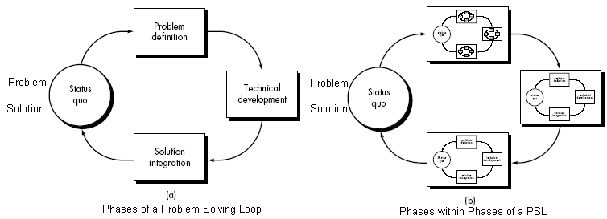
Software Process Models (Software Engineering Paradigm)
Development strategy that covers the process, methods and tools
Software development can be considered as a problem solving loop

Slide 38
Types of software process models :
Linear Sequential Model (Water Fall Model)
Prototyping Model
RAD Model
Evolutionary Model
Incremental Model
Spiral Model
Win-Win Spiral Model
Concurrent Development Model
Component Based Development
Formal Methods Models
Fourth Generation Technology Models

Slide 39
1. Waterfall model phases (Linear Sequential Model)
A systematic, sequential approach to a software engineering which starts at feasibility study and progresses through analysis, design, coding, testing and maintenance phase
Modeled after conventional engineering cycles
Theoretical Way of Developing Software??

Slide 40
Waterfall Model Phases
a. Software Requirement Analysis
- Requirement gathering process is intensified and focused specially on software
- Study of information domain
- Requirements for system and software must be determined and reviewed with customer

Slide 41
Waterfall Model Phases
b. Design
- It is a multi step process to address various aspects to be implemented such as data structures , software architecture, interface representation , procedural (algorithmic details) etc
- It translates requirements into representation of the software which can be assessed before the code generation
- Design document is also a part of the software configuration

Slide 42
Waterfall Model Phases
c. Code generation
- Design translated into a machine readable form
d. Testing
- It focuses on the logical intervals of the software (all statements) and functional externals of the software , tests to uncover errors
- Basic objective: Defined input should produce desired output

Slide 43
Waterfall Model Phases
Maintenance and Support
- Corrective Maintenance
- Perfective Maintenance
- Adaptive Maintenance
Software Configuration Items (SCI)
Source code, Executable, Design documents, SRS, Test cases etc
Change in user requirements

Slide 44
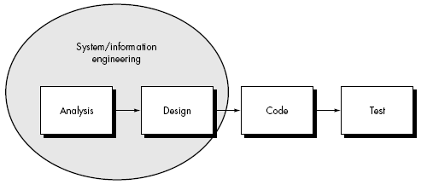
Waterfall Model (Linear Sequential Model)

Slide 45
Waterfall Model Phases
Drawback : Difficulty of accommodating change after the process is underway
Appropriate when requirements are well
understood

Slide 46
Prototyping Model
Requirements Gathering :
Define overall system objective
Track all known requirements
Outline areas of further development
Quick Design Approach:
Results in all user visible aspects
(input approach, output formats etc)
Construction of a Prototype :
Evaluated by the customer/user
Specify refinements in requirements

Slide 47
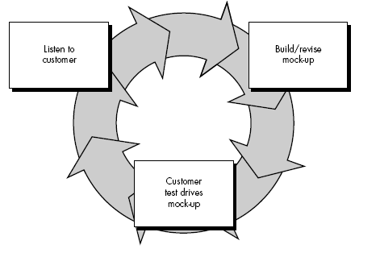
Prototyping Model

Slide 48
Prototyping Model
* Prototype serves as a tool to identify software requirements
* Working prototypes are built from existing program fragments or tools , libraries etc
Once done, what to do with working prototypes?

Slide 49
Problematic Aspects of Prototyping
I want a working version of my software immediately!!
I am not done yet! I only have a prototype ready!!
Customer
Developer

Slide 50
Problematic Aspects of Prototyping
I’ll have to make some implementation compromise to get the prototype work quickly
OK!! Just apply a few fixes to the prototype to make it a working product!!
Customer
Developer

Slide 51
Problematic aspects of Prototyping
Inappropriate OS or programming language may be used because it is available and known to the developer
Inefficient algorithms may be implemented
The less than ideal choice may become an integral part of the system!!

Slide 52
The RAD Model (Rapid Application Development)
Primarily used for information system applications
If requirements are well understood , and modularized , RAD process develops fully functional system within 60 to 90 days

Slide 53
Phases of RAD process
Business Modeling: Models information flow among business functions, various input process, output aspects of information
Data Modeling: Phase one is redefined into a set of data objects that takes part in business activity ( information process)
Process Modeling: The data objects are transformed thru processing to achieve the information flow
Application Generation : RAD model makes use of fourth generation techniques reuses existing a program comp0nents wherever possible any other automated tools to speed up the development process
Testing and turn over: Testing overhead is reduced due to reusability only the new components need testing

Slide 54
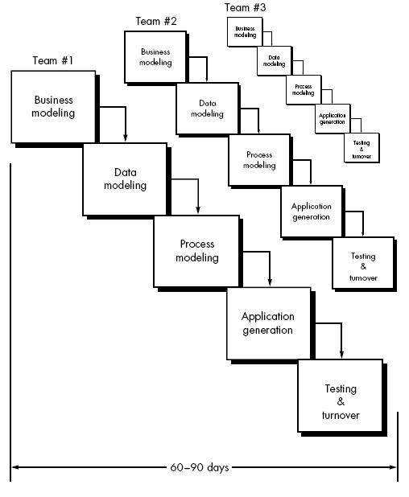
Phases of RAD process

Slide 55
Drawbacks of RAD Model:
Very High Human resource requirement overhead
Customer and developer both should be committed
All types of application are not appropriate for development under RAD strategy

Slide 56
Evolutionary Software Process Models:
Linear sequential model is meant for straight line (linear) development approach (delivers a complete product)
Prototyping helps the customer to understand the system requirements

Slide 57
Evolutionary Software Process Models:
Evolutionary models are inherently iterative in nature
It helps to develop increasingly more complete versions of the target software

Slide 58
Evolutionary Software Process Models:
Why models that accommodate product evolution?
Business and product requirement changes as the development proceeds Straight path to end product becomes unrealistic
Tight market deadline Limited version to be introduced
System requirements are well understood but details of product extensions or system extensions are not known

Slide 59
- Incremental Model - Spiral Model - Win Win Spiral Model - Concurrent development Model
Types of Evolutionary Software Process Models:

Slide 60
Incremental Model
It is a combination of linear sequential model philosophy with the iterative philosophy of prototyping paradigm
The model is outlined pictorially as below
Example of Incremental Model: Word processing Software
First Increment: the core product (Basic Word Processing Application Software
Basic WP requirements are addressed
Supplementary features (Known + unknown) are not delivered
Core is used by the customer (undergoes detailed review)
Helps to plan next development in order to better meet customers need and delivery of additional features and functionality

Slide 61
Subsequent increments: This process is repeated each time until the complete product is produced (final version)
Each increment is a stripped down version of the final product
Each version fulfills users need and provides a platform for evaluation by the user and hence for their development

Slide 62
Benefits:
Low manpower requirement
Early increments can be implemented with fewer people
Increments can be planned to manage various technical risk (change in hardware platform , OS features etc)

Slide 63
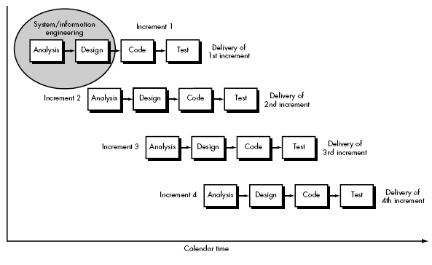

Slide 64
4 b. Spiral Model (Proposed by Bohem)
This evolutionary software process model combines the iterative nature of prototyping model , the control and systematic aspect of linear sequential model
It has potential for rapid development of incremental versions of the software
Software is developed in a series of incremental releases
Early stage increments: paper model or prototype
Subsequent stage releases: more complete version of required software

Slide 65
Spiral Model is divided into a number of Frame Work Activities or Task Regions .
There are six task regions or frame work activities:
Customer Communication: Task for effective communication between customer and developer
ii. Planning : Task is to define resources, timeline and other project related information
iii. Risk analysis: the task is to assess technical and management risks
iv. Engineering: task required to build one or more representations of the application
Construction and release: task to construct, test, install and provide support (documentation, training etc)
Customer evaluation: task is to obtain customer feedback or evaluation (engineering stage versus implementation stage)

Slide 66
Spiral model handles the software development process in phase manner, each phase being treated as a project work
Spiral model divides the development process into four projects:

Slide 67
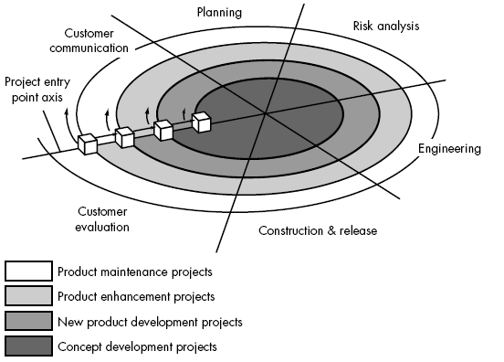

Slide 68
Each region is populated by a series of tasks specific to the nature of the project
In all cases , umbrella activities are applied (SCM and SQA)
All the stages iterative in nature:
First Iteration: Results in production of product specification
Second Iteration: Results in production of product prototype
Next Iteration: Results in production of progressively more sophisticated versions of the software

Slide 69
Each pass thru the planning region two results in adjustment to the project plan
Cost and schedule adjusted on the basis of customer evaluation
Project manager adjusts the number of iterations to complete the software
Classical model ends when the software is delivered. Spiral model can be applied thru out the life of the software
Each project in the Spiral model has a starting point in the project entry point axis, which represents the start of a different type of project
Spiral model remains active until the software retires

Slide 70
Spiral model is a realistic approach to development of large scale projects
Spiral model uses Prototyping as a Risk Reduction mechanism. Prototyping is applied at any stage of the product
It incorporated systematic approach as suggested by classical life cycle of software in an iterative way (frame-work)
It demands direct consideration of technical risk
Discussions:
Difficult to convince customer that evolutionary approach is controllable
High expertise is required to assess considerable risk
This is a new model not used widely as linear sequential development approach
It will take number of years before the effectiveness of this model is known

Slide 71
4 c. Win-Win Spiral Model
Spiral model suggests customer communication to decide upon project requirements form customer
Developer asks what is required and customer provides necessary details
In reality, developer negotiates with customer for functionality , performance, and other product /system features against cost and time to market
Negotiation is successful at Win-Win state:
Customer wins by getting a product /system that satisfies majority of his requirements
Developer wins by deadline target and achievable budget

Slide 72
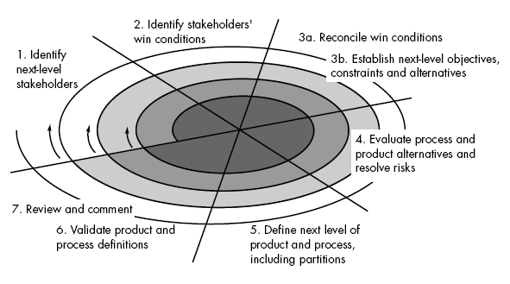

Slide 73
Negotiation takes place at the beginning of each pass around the spiral , involving the following activities:
Identification of the key stake holders of the system/sub systems
Determination of the stake holder’s win condition
Negotiation of the stake holder’s win condition to fit into a set of Win-Win conditions
for all concerned (including software development project team)

Slide 74
4 d. Concurrent Development Model (by Davis and Sitaram)
Project managers tracking status of major phases of a project have no idea of project status since personnel are associated with more than one activity - might be writing SRS , doing design , coding , testing etc. all simultaneously
This shows existence of concurrency of activities occurring in any one phase (requirements change during late development) which can be represented by notations to represent the state of a process (state chart)
Existence of concurrency of activities affect the time bound nature of software development process

Slide 75
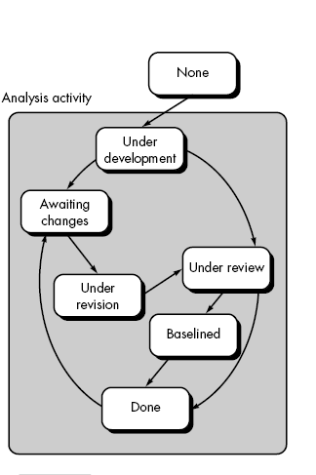

Slide 76
Representation:
Any state of a concurrent process model can be represented schematically as a series of major technical activities, tasks and associated states e.g. analysis, activity can be represented as shown
All activities resides concurrently but resides in different states
For a Spiral Model :
When customer communication activity completed the first iteration and is in state three the analysis activity makes a transition from state one to state two.
Now as a part of customer communication activity , the customer signals a change in requirement , analysis activity makes a move to state three
Concurrent process model defines a series of events that will trigger transition from state to state for each software engineering activity
In general this model is used as a paradigm for client server applications which comprises of a set of functional components

Slide 77
Concurrent development model defines client/server applications in two dimensions:
System Dimensions: involves three activities (design, assembly, use)
Component dimensions: involves two activities (design and realization)
Concurrency is achieved in two ways:
i. System and component activities can be concurrently taking place (a state oriented approach)
ii. Design and realization of many components can take place concurrently

Slide 78
Comments:
Applicable to all types of software developments
Helps to figure out the actual picture of the state of the project
Instead of showing software engineering activities as a sequence of tasks it defines a network of activities existing simultaneous with other activities
Events generated in one activity may trigger a state transition of an activity

Slide 79
5. Component Assembly Model
Component Assembly model is based on the principle of Object Oriented Technology
OOT emphasizes creation of class that encapsulates both data and the algorithm (code) that are used to manipulate the data
OOT provides very high level of reusability
Component assembly model resembles spiral model
It is evolutionary in nature and uses iterative approach to develop software
It composes applications from prepackaged software components (class)

Slide 80
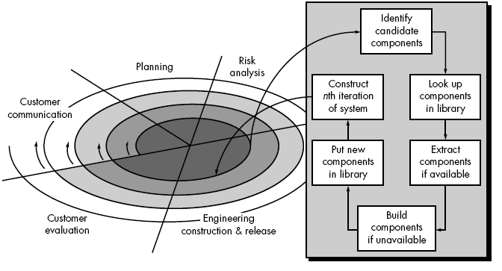

Slide 81
5. Component Assembly Model contd…
Accomplished by examining the data that are to be manipulated by the application and the algorithms that will be applied to accomplish manipulation these data and code are packaged to form a software component or a class
Old classes are stored in class libraries
This model leads to software reuse
Reusability provides measurable benefits to software engineering processes
QSM Inc. report indicates:
70% reduction in development cycle time
84% reduction in project cost
26.2% productivity index versus 16.9 as industry norm

